Slide 1
IMPORTANT, PLEASE NOTE:- The audio song (final slide) will not play until you have copied the Handy Heroes Song Mp3 file onto your desktop and then embedded the file into the relevant slide. Please follow the instructions below.
Instructions to embed the audio song (final slide) into your presentation:
First copy the audio file (HANDY HEROES SONG. Mp3) to your Desktop.
Go to the slide and Insert Sound
Insert Sound from your Desktop
Go to the start of the Presentation and play Slide Show – click for the next slide

Slide 2
Today
is
Global Handwashing Day

Slide 3
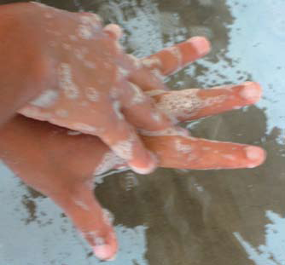
Children all over the world wash hands with soap to stay healthy

Slide 4
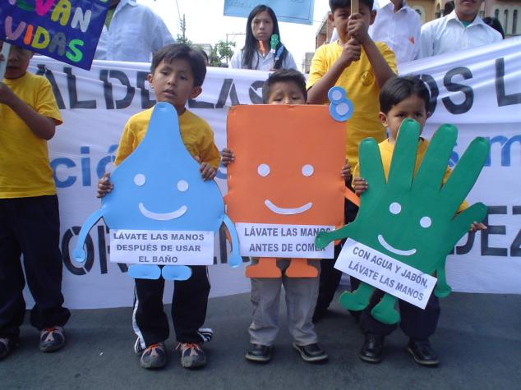
Children in Bolivia celebrate Global Handwashing Day

Slide 5
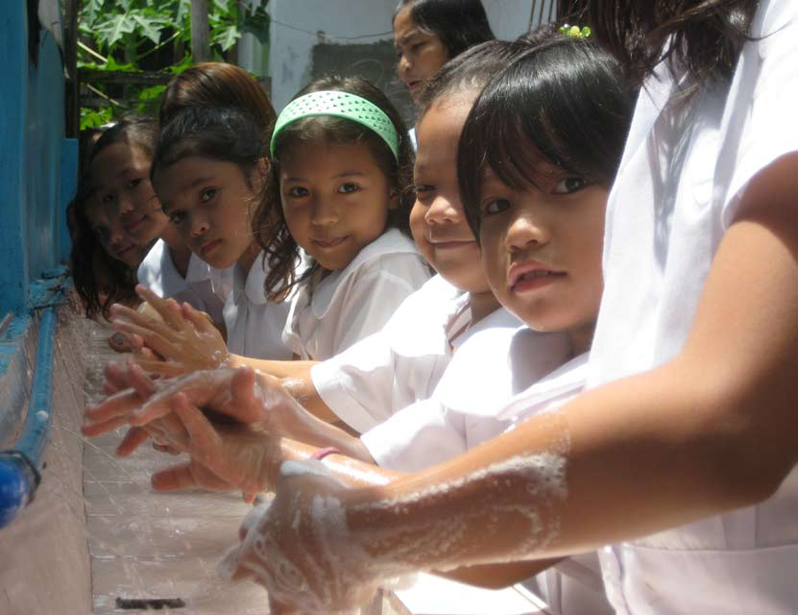
Photo used with the kind permission of ‘Fit for School Inc’
Children in the Philippines wash their hands with soap before eating lunch

Slide 6
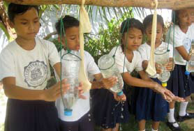
Schoolchildren in the Philippines using Tippy Taps and soap

Slide 7
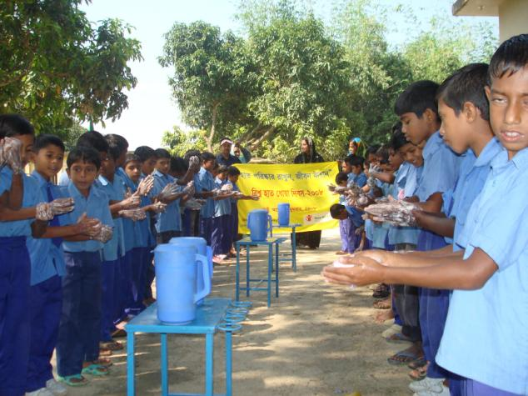
School boys in Bangladesh learn how to wash their hands properly

Slide 8
